Slide 1

Unit 5: Project 5:
A job interview

Slide 2
Task 1:
How to prepare for a job interview? Check the following steps and explain why they are important.

Slide 3
Task 2: Listen to the interview and circle the correct answer.
https://www.e-sfera.hr/dodatni-digitalni-sadrzaji/569a955f-e7dc-4c03-9870-813cbe3c5b13/

Slide 4
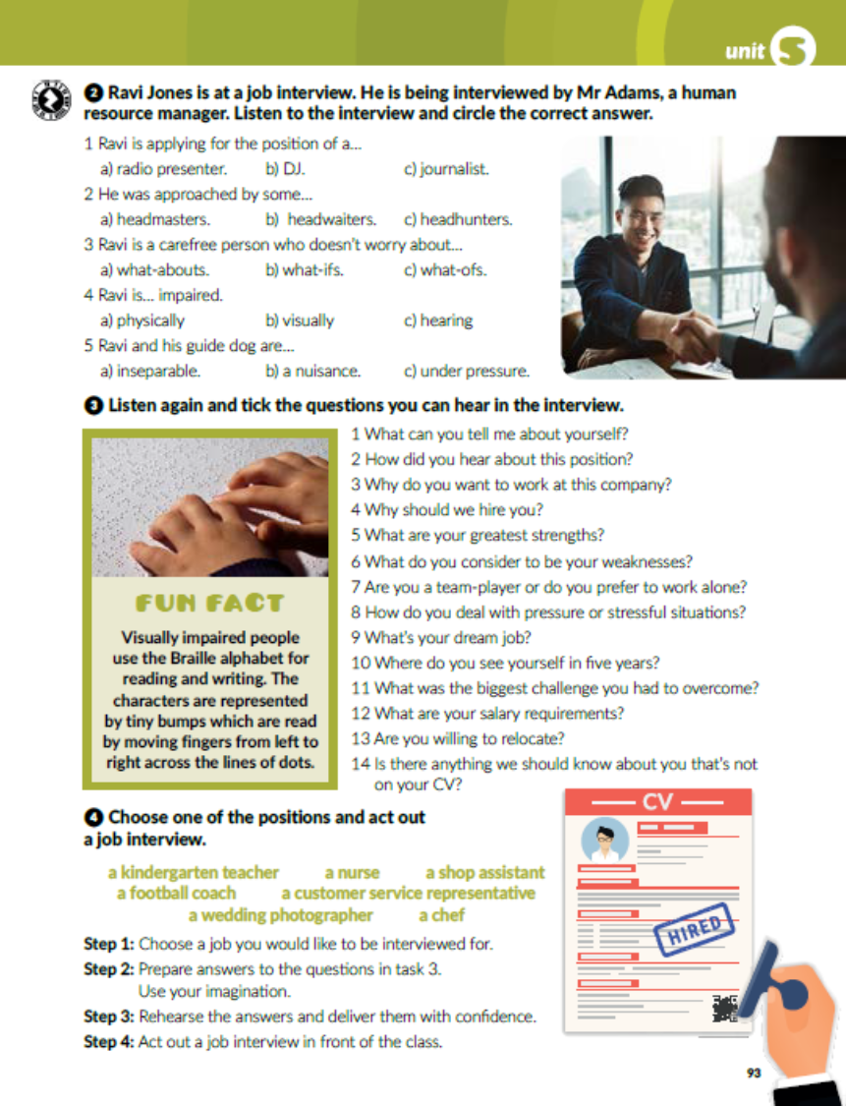

Task 3: Listen again and tick the questions you can hear in the interview.
✓
✓
✓
✓
✓

Slide 5

Task 4: Choose one of the positions and act out a job interview.

Slide 6
workbook, page 97
Task 1: Match the sentence parts. Poveži.
3
6
2
5
4

Slide 7
Task 2: Match the questions and answers.
3
6
7
5
4
11
13
2
14
10
9
12
8

Slide 8
Task 4: What do you think? Will Daisy get the job?

